Slide 1

The Hackathon Experience
Illustrations by Microsoft
An event for creative and passionate people.
Gabriel Montalvo Rivera / gmontalvo.me
Business Analytics Specialist Intern at Microsoft

Slide 2
A Hackathon is where coders, designers and business people come together to create great products over the course of a weekend, while learning from experts and sharing your knowledge and skills with other people.
Notes:
An event for creative and passionate people.

Slide 3
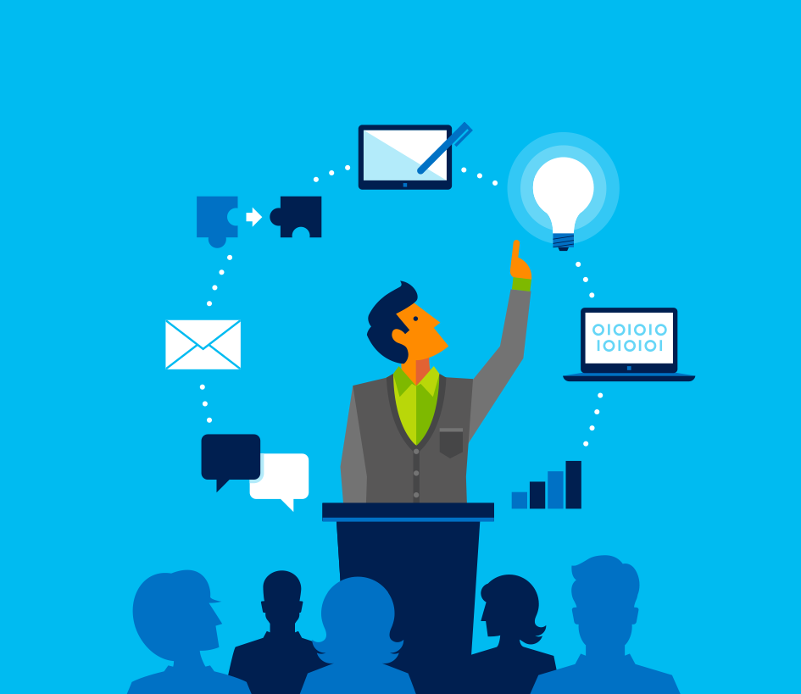
Things you can take from participating in these events
A great opportunity to challenge yourself
Learn a new programming language
Work on UX/UI design
Build Project Management skills
Experience
Team work
Talk with experts in the industry
Present your idea or project
Contribute to the community

Slide 4
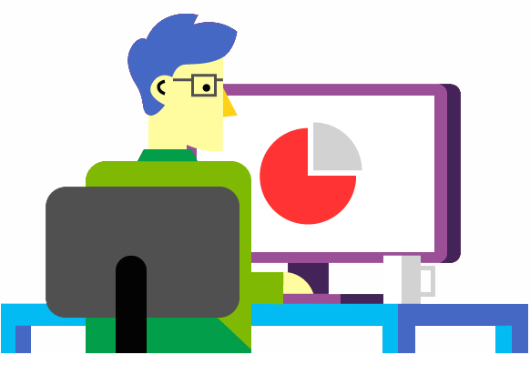
Where I’ve been so far…
My team and I have participated in many hackathons around the island, and we’ve built applications that range all the way from fashion and electronic commerce applications to assistive technology tools for the disabled.

Slide 5
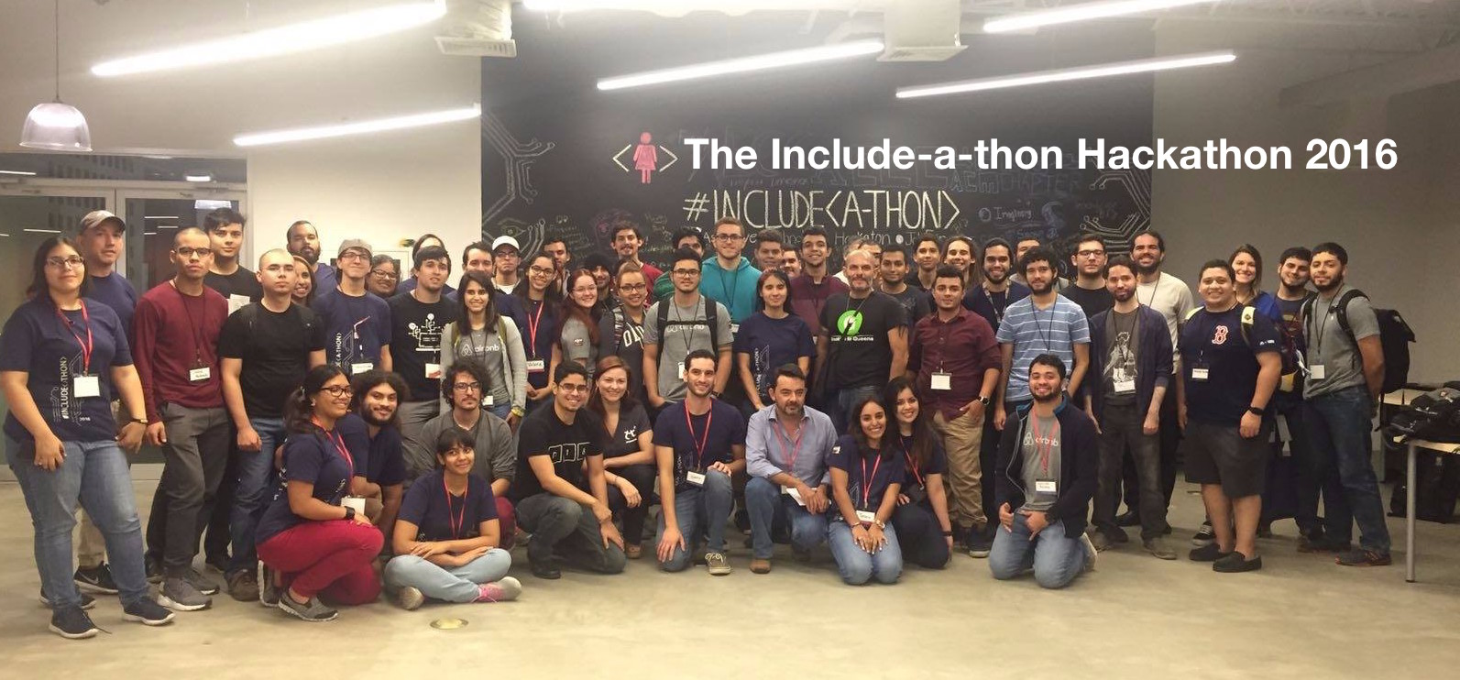
Building Assistive Technologies for the Community at the Include-a-thon 2016 Hackathon

Slide 6
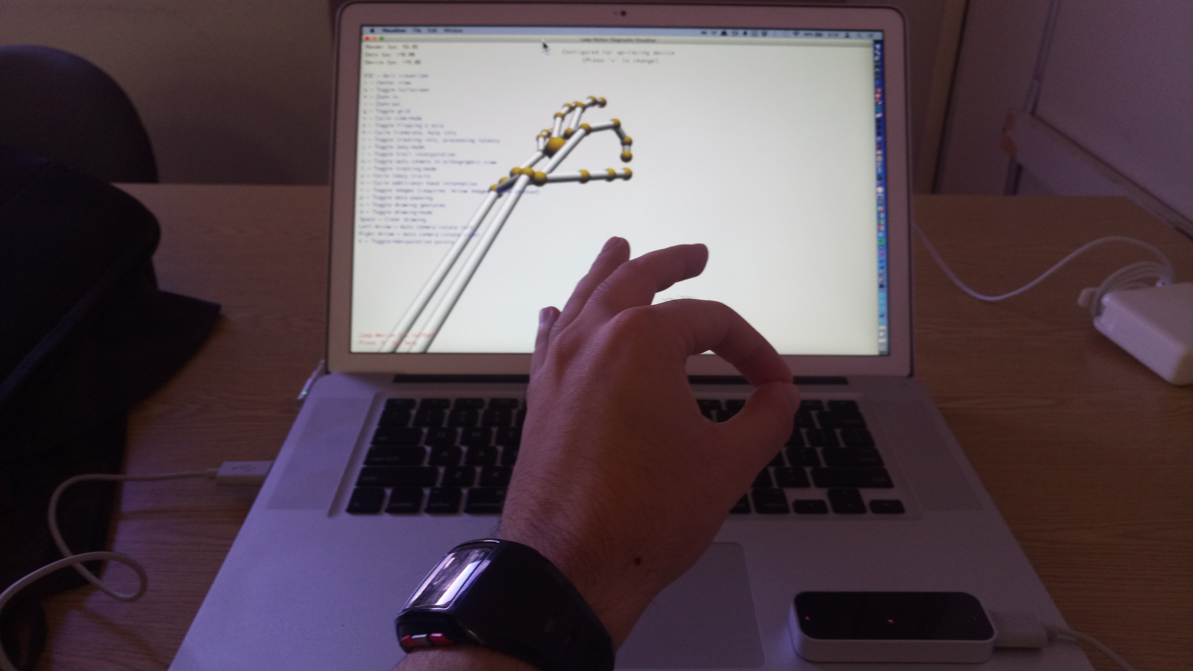
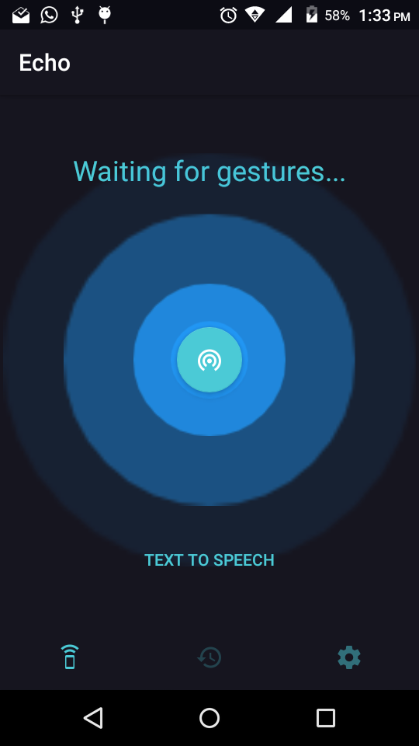
The Echo Virtual Assistant
Built with the Leap Motion Controller, NodeJS and Android

Slide 7
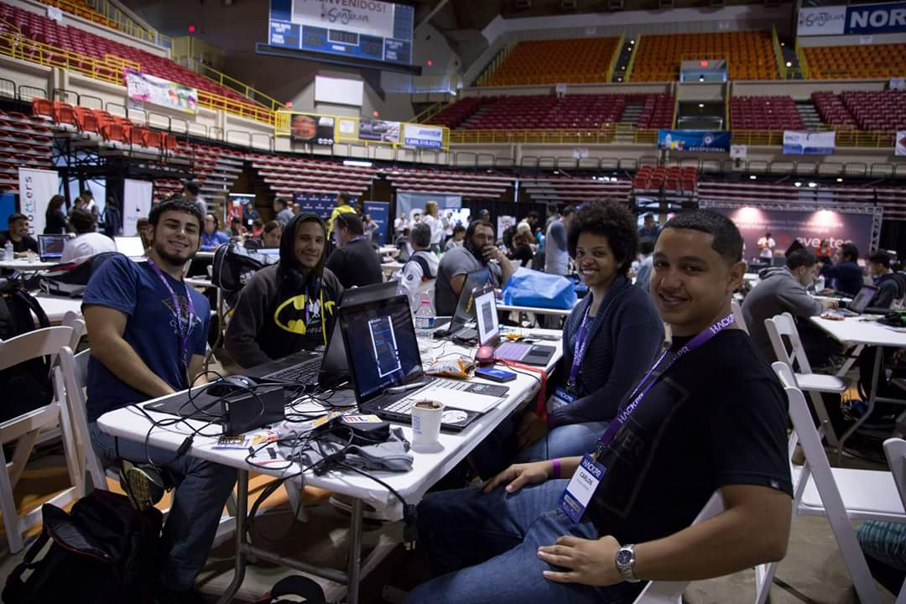
Awesome, I’m in! But where should I go?
There are lots great of hackathon communities in Puerto Rico
Most of these events are driven by student initiatives from many schools with the support of companies like Microsoft

Slide 8
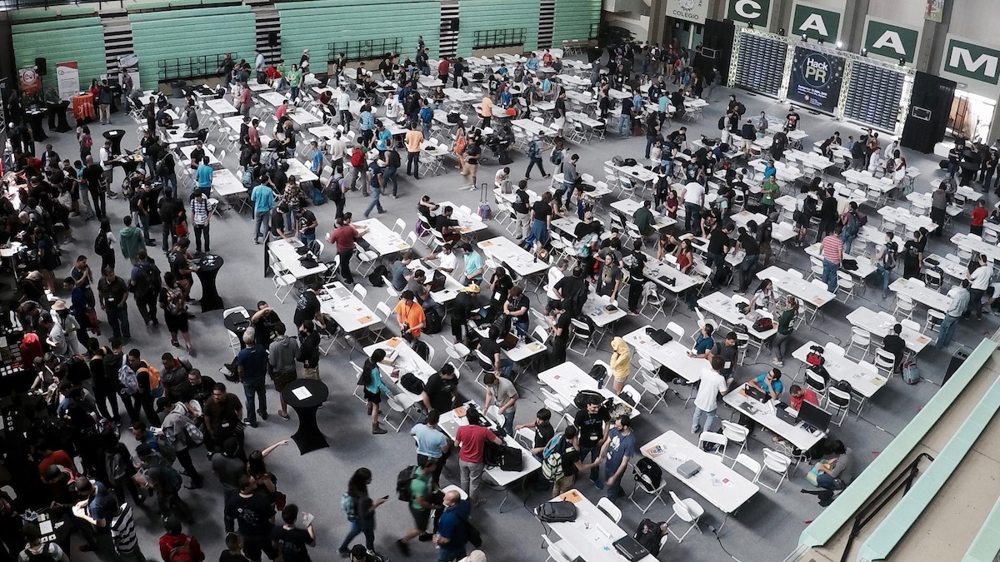
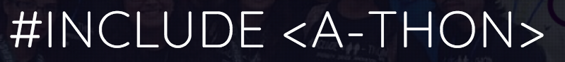
HackPR

Slide 9
So go out and explore!
… and don’t forget to have fun in the process.
Hackathon Websites:
HackPR – http://hack.pr/
Include-<a-thon> Hackathon – http://hackathon.includegirls.com/
You can find and download this presentation at:
https://github.com/gmontalvoriv/Microsoft-Presentation-2016-TheHackathonExperience

